Slide 1

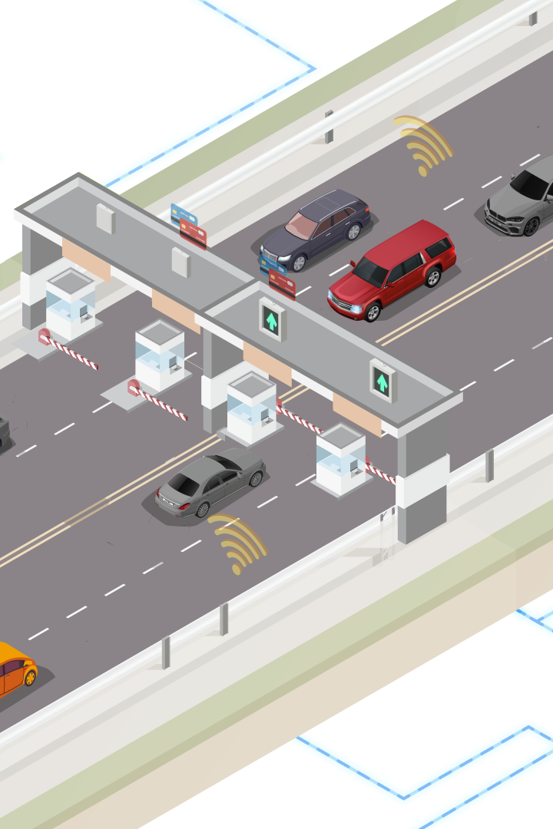
Automated Toll Collection System
Submitted by (Group 04):
Tahnia Oqba (ID: 20200105232)
Mahir Faisal (ID: 20200105233)
Saji Pal (ID: 20200105235)
Abdullah Al Shafe (ID: 20200105236)

Slide 2
Outline
What is ATC
Project Purpose
Circuit Diagram
Equipment Used
Working Principle of Equipment
Project Flow
System Functionalities
Security and Privacy
Challenges Faced
Implementation and Benefits
Limitations of ATC System
Conclusion and Future Work

Slide 3

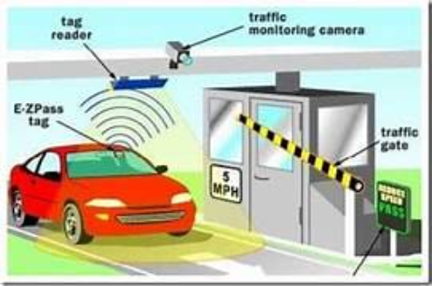
What is Automatic Toll Collection (ATC) System?
Automatic Toll Collection (ATC) system is an electronic system that collects tolls automatically without the need for drivers to stop their vehicles. It uses RFID technology to read the RFID tag attached to the vehicle and deducts the toll amount from the prepaid account of the vehicle owner. This improves traffic flow and the payment experience for drivers at toll gates.

Slide 4
Project Purpose
Reduce Traffic Delays
Improve Payment Experience
Long lines and traffic delays at toll gates are a major problem during peak hours. Our system eliminates delays by providing a seamless payment experience.
Traditional payment methods are slow and can cause further delays. Our system provides a hassle-free experience, with drivers never having to leave their car.
Easy Integration
Enhanced Security
Our system can be integrated into existing toll gates with minimal changes required to the infrastructure.
Our system uses RFID technology to ensure secure and accurate payments. There is no risk of fraud or misuse of payments.

Slide 5
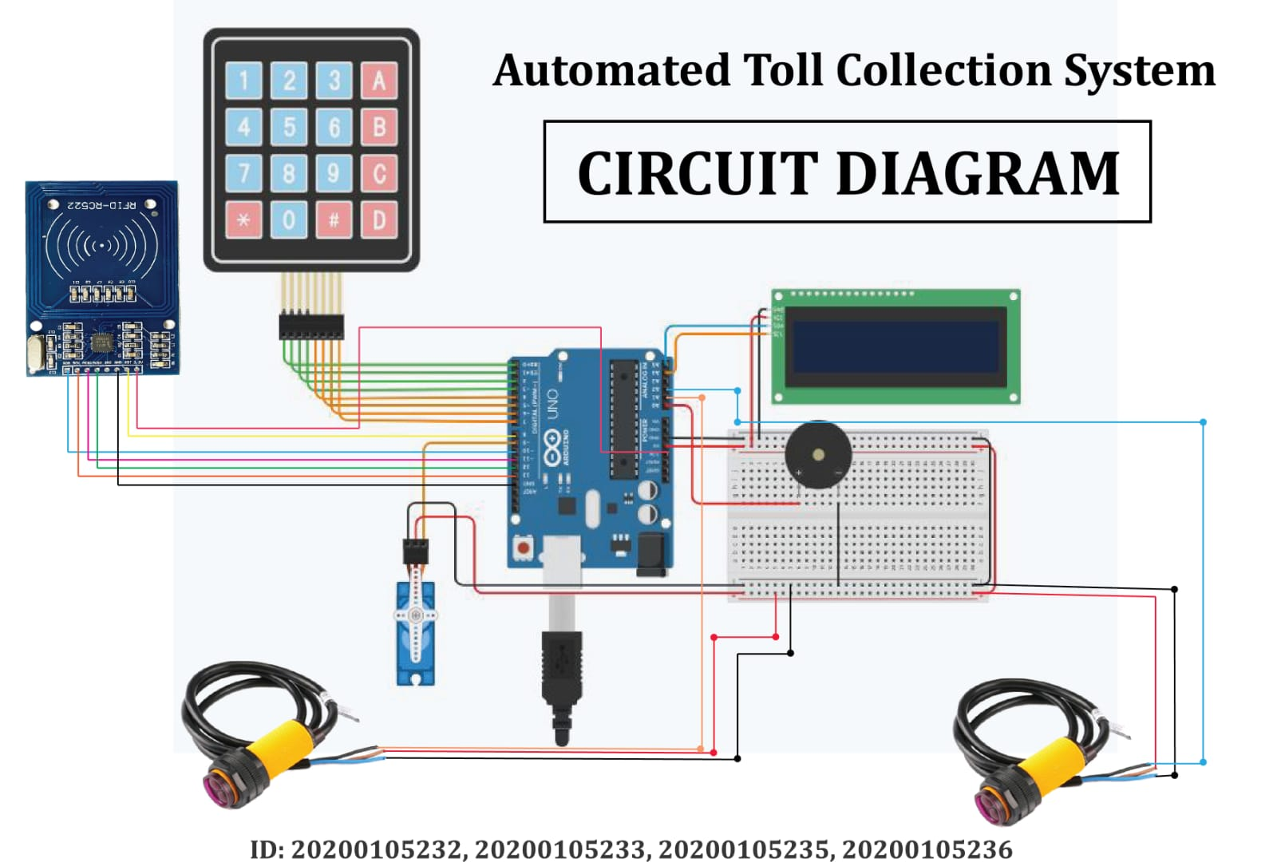
Circuit Diagram

Slide 6
Equipment Used
IR Obstacle Sensor
20*4 LCD Display
RFID Reader
Servo Motor
RFID Card
1
2
3
4
5
6
7
8
9
10
Arduino Uno
RFID Tag
4*4 Keypad
Buzzer
I2C Module

Slide 7

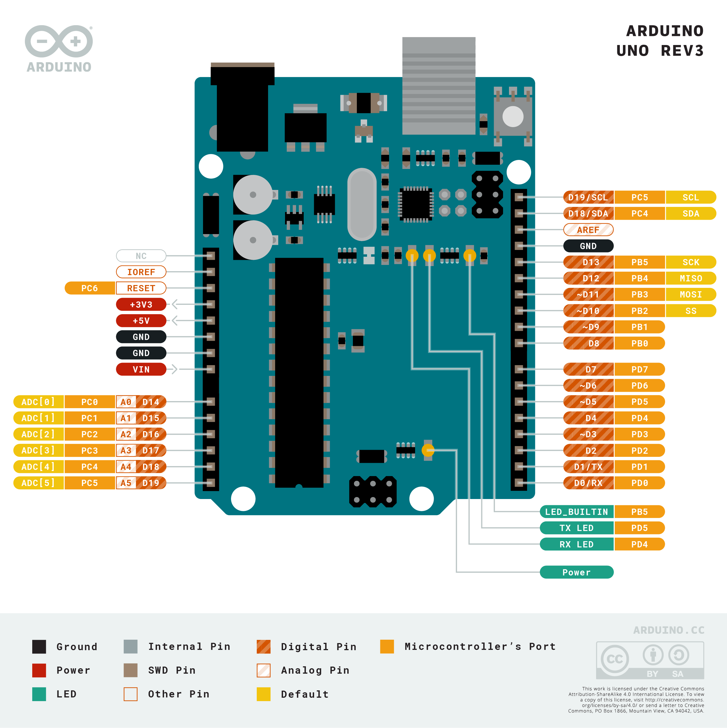
Arduino Uno
The Arduino Uno is a microcontroller board based on the ATmega328P. It has 14 digital input/output pins, 6 analog inputs, a 16 MHz quartz crystal, a USB connection, and a power jack. It's widely used in electronic projects due to its flexibility and ease of use.

Slide 8
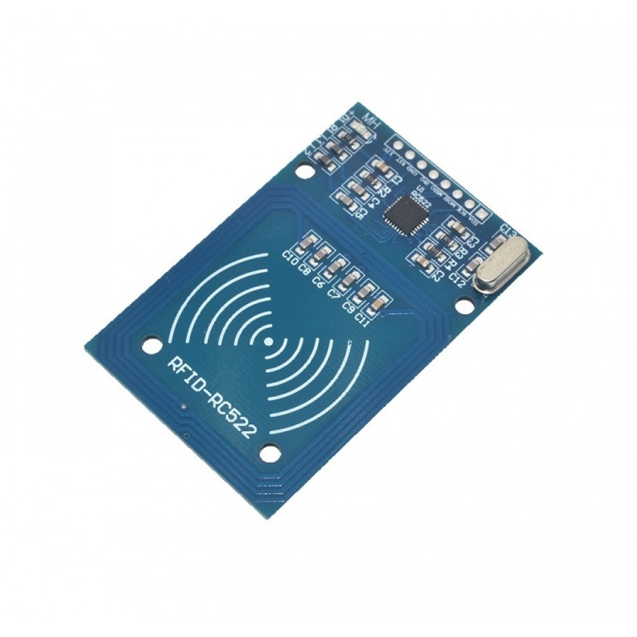
RFID Reader
The RFID reader is an electronic device that uses radio waves to read and capture information stored on RFID tags. It's commonly used in access control systems, inventory management, and payment systems. Our project uses an RFID reader to automatically detect the presence of vehicles and collect tolls.

Slide 9
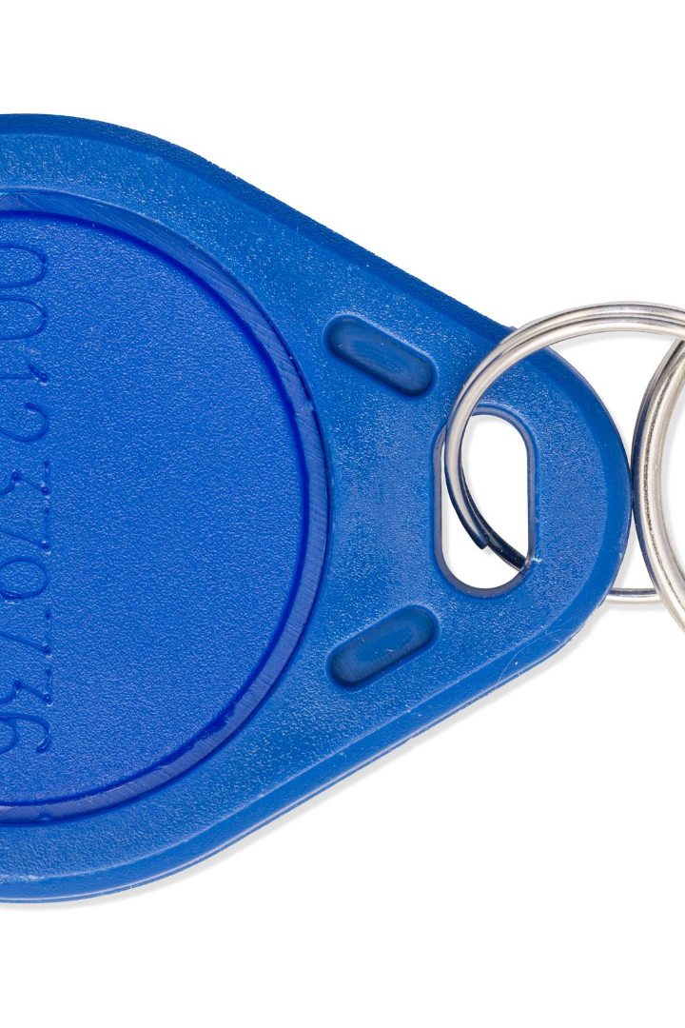
RFID Tag
The RFID tag is a small electronic device that contains a unique ID number. It's used in conjunction with an RFID reader to track and identify objects in various industries, including transportation, retail, and manufacturing. Our project uses RFID tags to automatically collect tolls from vehicles.

Slide 10

RFID Cards
RFID (Radio Frequency Identification) cards are small, portable devices that are used for identification, access control, and other applications. In our project, RFID cards are used to allow vehicles to pass through the toll booth without stopping. The RFID reader scans the card and sends a signal to the microcontroller to trigger the servo motor.

Slide 11
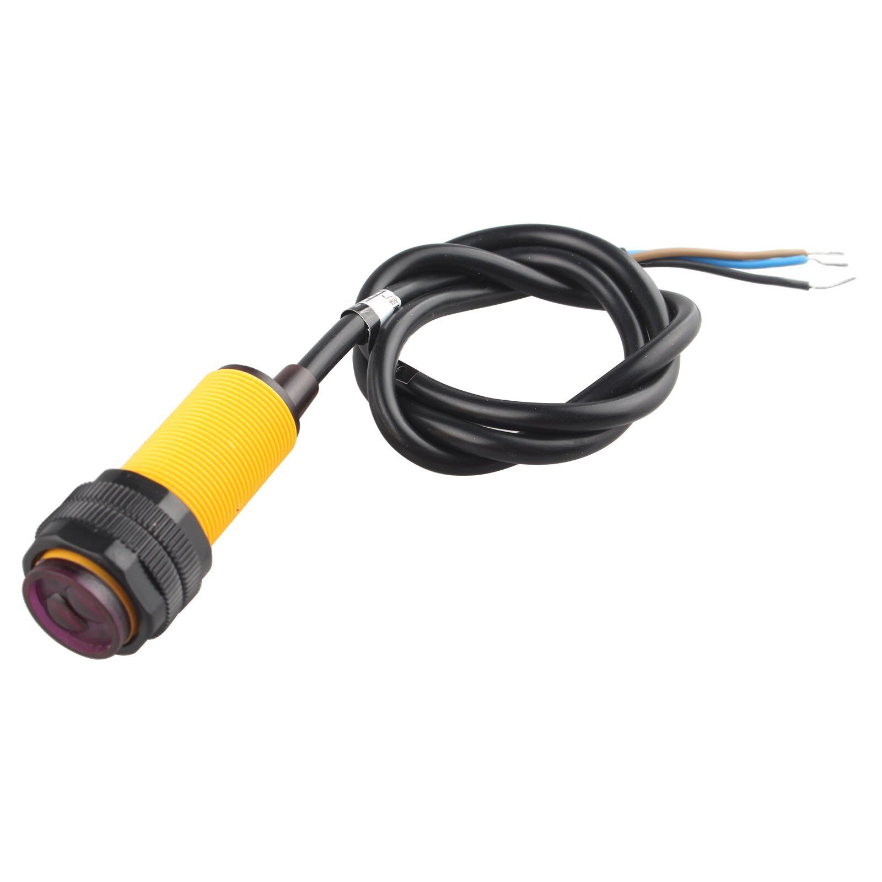
IR Obstacle Sensor
The IR obstacle sensor is a device used to detect the presence of objects in its field of view. It uses infrared light to detect the presence of obstacles and sends a signal to the microcontroller to trigger the servo motor. In our project, the IR obstacle sensor is used to detect the presence of vehicles at the toll booth.

Slide 12
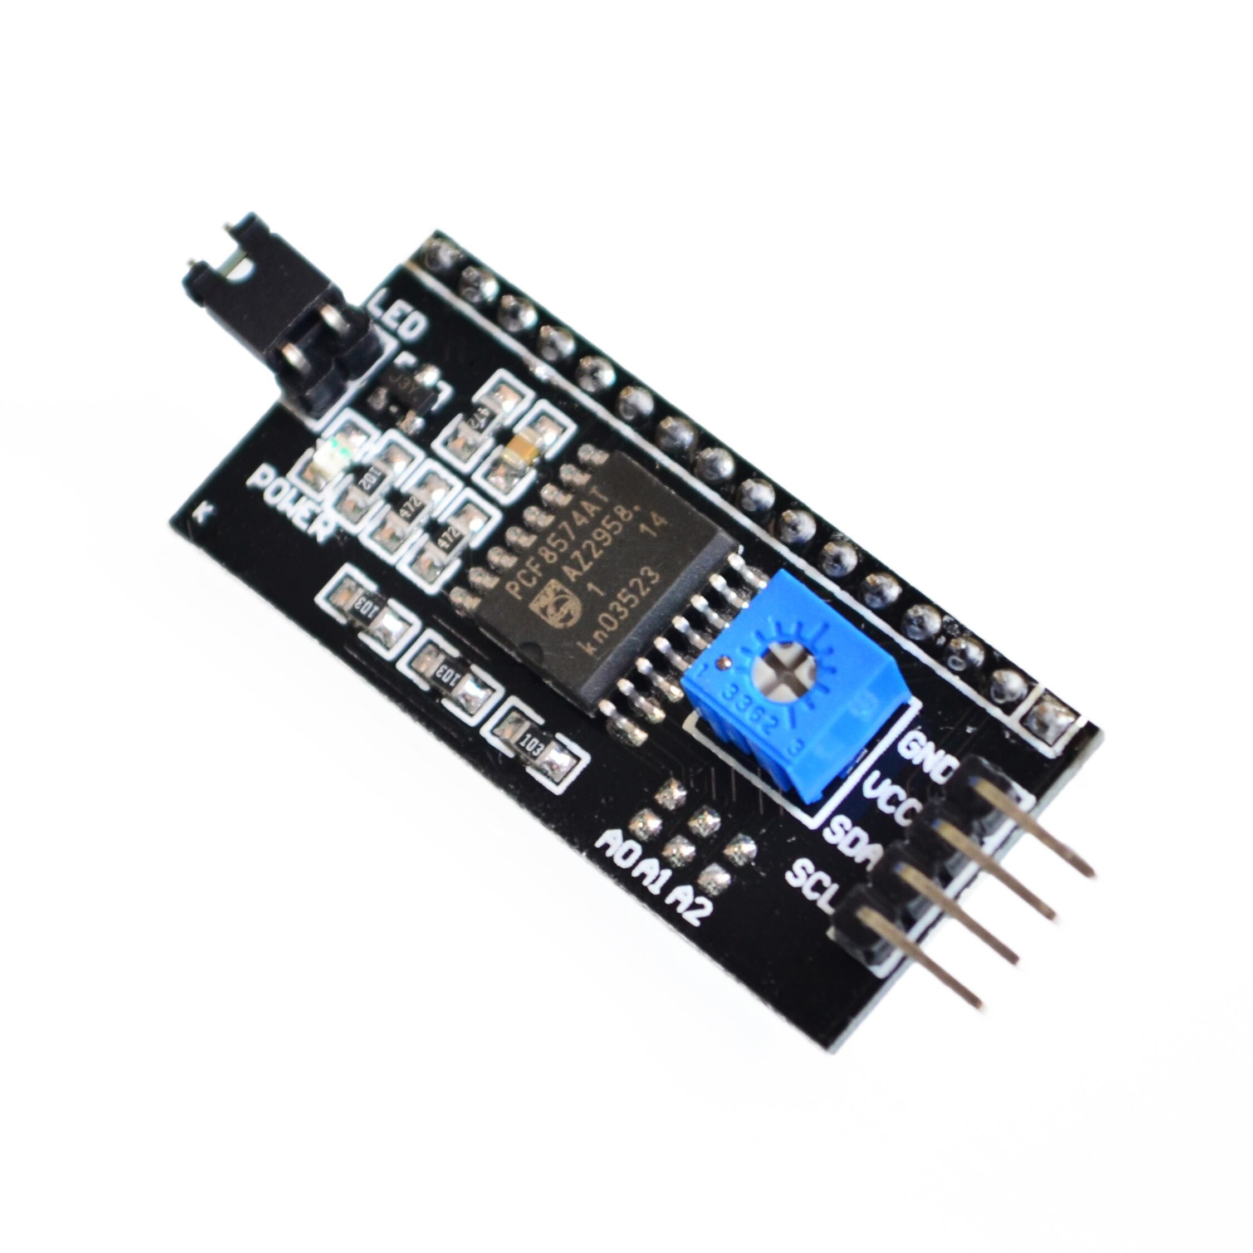
I2C Module
The I2C module is a communication protocol used to exchange data between different devices in a system. It allows multiple devices to communicate with each other using only two wires. In our project, the I2C module is used to exchange data between the microcontroller and other peripheral devices.

Slide 13
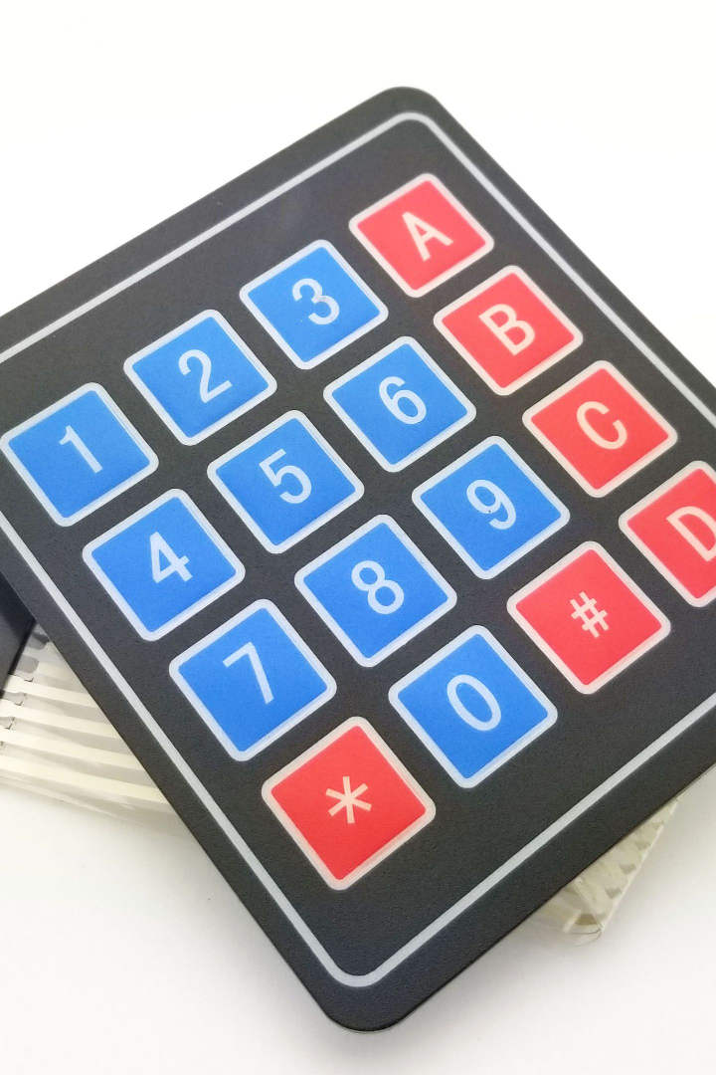
4x4 Keypad
The 4x4 keypad is an input device used to enter data into electronic circuits. It consists of 16 keys arranged in a 4x4 matrix. In our project, the keypad is used to enter the user's vehicle registration number, which is then used to deduct the toll.

Slide 14
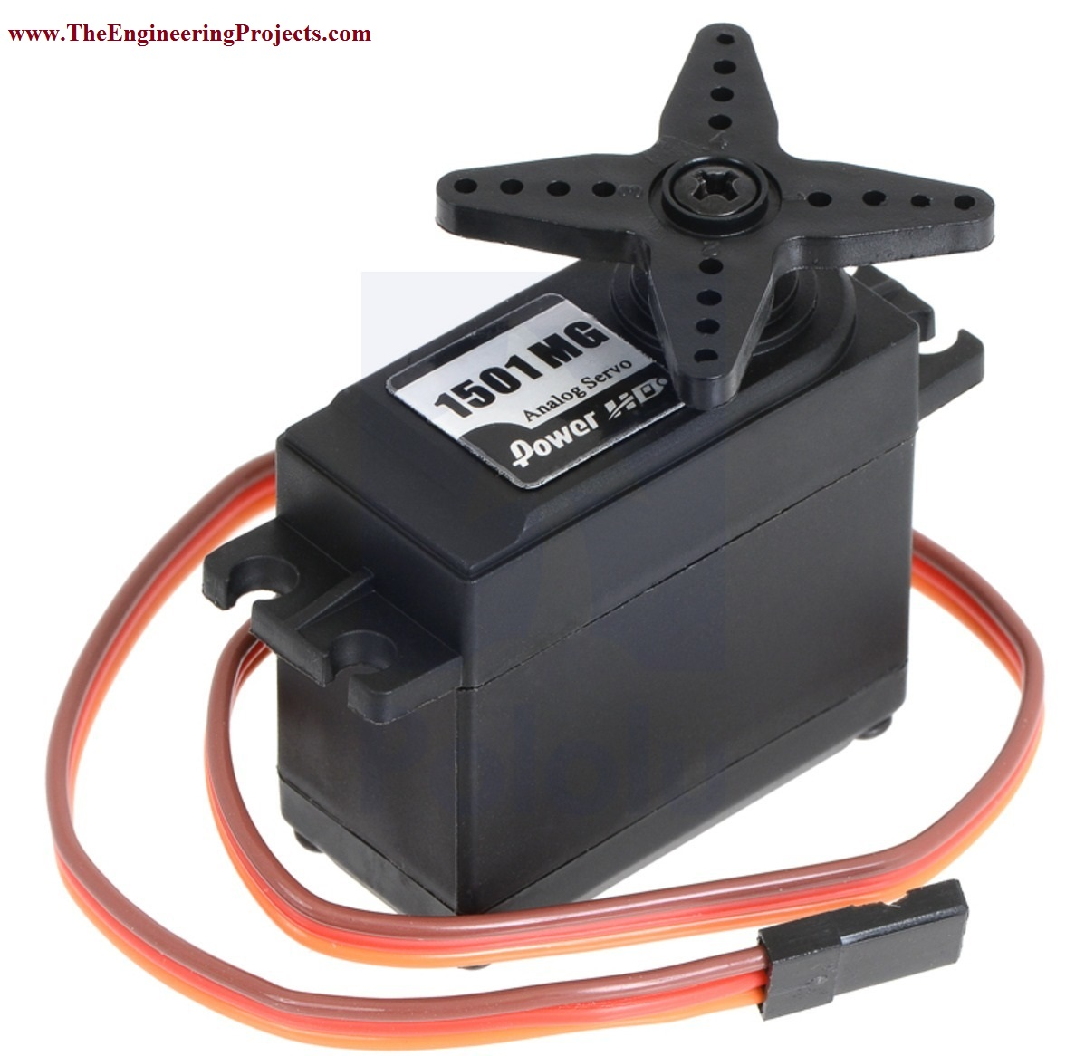
Servo Motor
A servo motor is an input device used to control the position of an output shaft. It is a type of rotary actuator that allows for precise control of angular position. In our project, the servo motor is used to open and close the barrier gate at the toll booth.

Slide 15
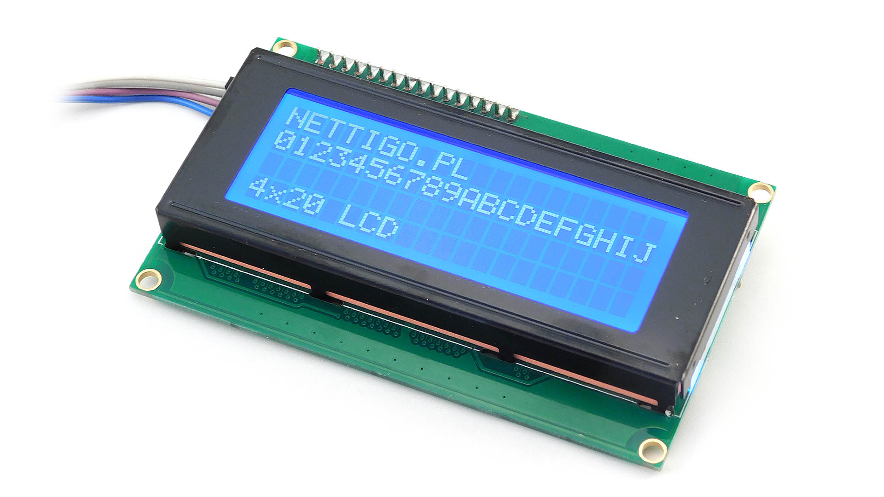
20x4 LCD Display
The 20x4 LCD display is a visual output device used to display information in electronic circuits. It can display up to 80 characters in four rows of 20 characters each. In our project, the LCD display shows the user's vehicle registration number and the amount of toll deducted.

Slide 16
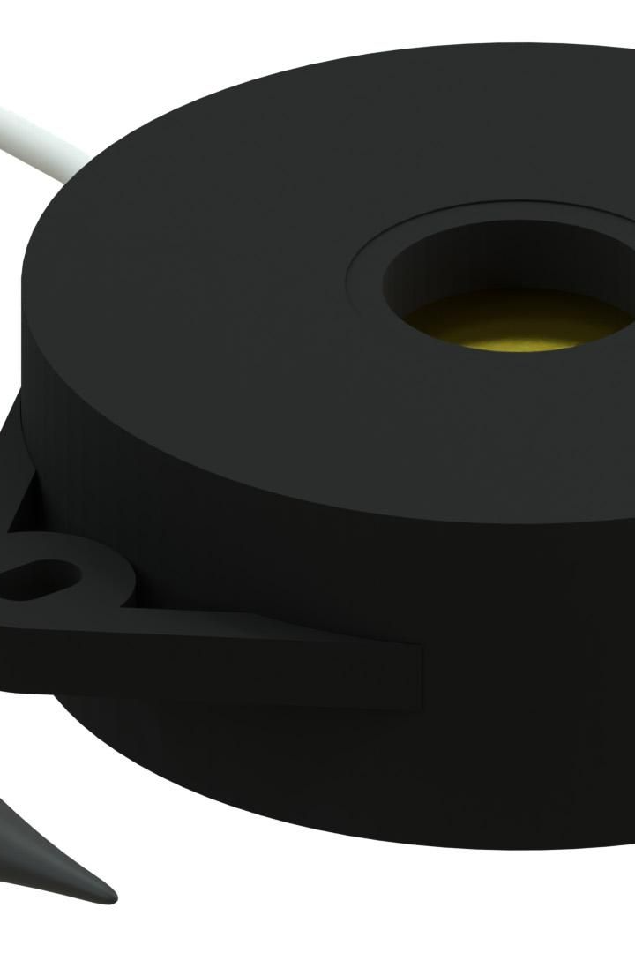
Buzzer
The buzzer is an audio signaling device that produces a continuous or intermittent sound. It's commonly used in various electronic circuits as an alarm or warning signal. In our project, the buzzer alerts the driver once the toll is deducted.

Slide 17
Project Flow
1
Vehicle Approaches Toll Gate
The presence of a vehicle is detected by the IR obstacle sensor and the LCD display shows the toll fare.
RFID Tag Identification
2
The RFID reader identifies the unique tag number and passes it to the Arduino Uno for verfication.
3
Payment Processing
If the tag is identified, the fare is automatically deducted from the driver's account and the servo motor opens the toll gate.
Buzzer Notification
4
A confirmation beep sounds indicating successful fare payment and the LCD display shows a "Thank You" message.

Slide 18
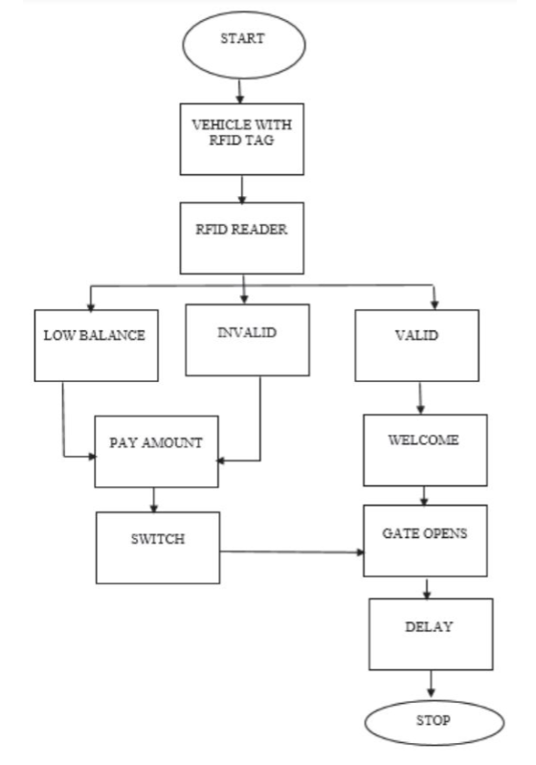
Block Diagram

Slide 19
System Functionalities
The ATC system uses advanced algorithms to identify and classify vehicles, ensuring accurate toll collection. The system also features real-time transaction processing, enabling instant payments and reducing congestion at toll booths. Users can choose from various automated payment methods, including prepaid, postpaid, and mobile apps. The system also integrates with e-wallets and payment gateways for added convenience.

Slide 20

Security and Privacy
The Automatic Toll Collection (ATC) system uses RFID technology to identify vehicles and charge tolls. It is important to maintain the security and privacy of drivers' information. The system stores all data securely and ensures that drivers' personal information is not shared with unauthorized parties.

Slide 21
Challenges Faced
1
Integration with Existing Infrastructure
2
Communication Between Components
3
RFID Tag Accuracy
Maintaining accurate records of payment was another challenge, but was resolved through the use of reliable RFID technology.
Integrating the system with existing toll gates took longer than expected but was necessary to minimize infrastructure changes.
Ensuring seamless communication between the different equipment components was a major challenge but was overcome through rigorous testing and calibration.

Slide 22
Implementation and Benefits
Practical Application
Traffic Flow Improvement
The automatic toll collection system is being implemented in various areas of the country and is expected to be rolled out on a wider scale soon.
The system is successfully reducing traffic delays at toll gates which promotes better traffic flow and less pollution on the roads.
User Convenience
Reduced Costs
Drivers no longer have to stop, pay and wait in long queues, thereby making the driving experience more comfortable and convenient.
The system is reducing the costs of installing and maintaining traditional toll gates and also reducing the budget required to manage the heavy traffic flow.

Slide 23
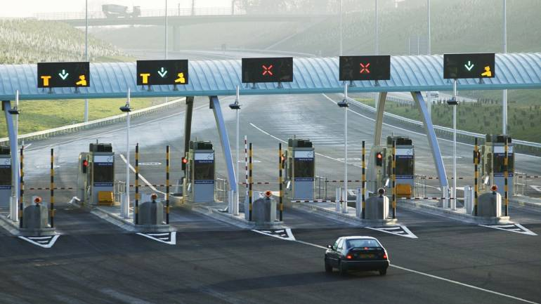
Limitations of the ATC System
While the ATC system offers many benefits, there are also some limitations that need to be addressed. They can suffer from technical glitches and equipment failures, disrupting operations. Compatibility issues with lacking RFID tags or misplacement on vehicles cause communication errors. False readings due to tag misalignment or external interference lead to billing inaccuracies. Privacy concerns arise from data collection and potential vehicle tracking. Maintenance is essential but incurs costs. Weather effects and scalability challenges during traffic peaks affect performance. High implementation costs and security vulnerabilities, including hacking risks, demand attention.

Slide 24
Conclusion and Future Work
The automatic toll collection system is a game-changer in the world of transportation and promises to alleviate many of the issues associated with traditional toll gates. With technological advancements continuing to evolve, there are likely to be many future improvements on this technology.

Slide 25
THANK YOU

